Slide 1

I
Structural Pattern
Decorator Pattern

Slide 2
Decorator Pattern
Intent
Attach additional responsibilities to an object dynamically. Decorator provide a flexible alternative to subclassing for extend funtionality.
Also Known As
Wrapper

Slide 3
Decorator Pattern
Applicability
Use decorator in the follow scenarios:
To add responsibilities to individual objects dynamically and transparently, that is, affecting other objects.
For responsibilities that can be withdrawn in any moment.
When extension by subclassing is impractical. Sometimes a large number of independent extensions are possible and would produce an explosion of subclasses to support every combination. Or a class definition may be hidden or otherwise unavailable for subclassing.

Slide 4
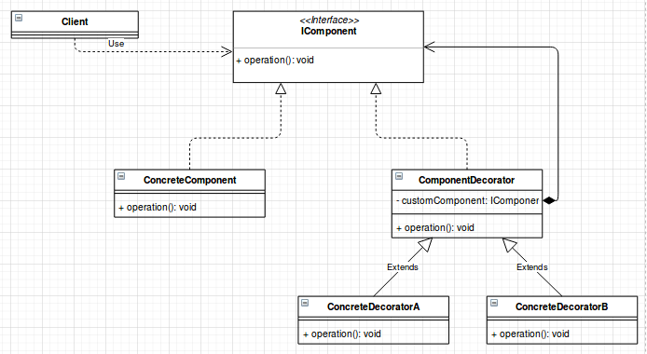
Decorator Pattern
Structure

Slide 5
Decorator Pattern
Participants
Component:
Defines the interface for objects that can have responsibilities added to them dynamically.
ConcreteComponent:
Defines an object to which additional responsibilities can be attached.
Decorator:
Maintains a reference to a Component object and defines an interface that conforms to Component’s interface.
ConcreteDecorator:
Adds responsibilities to the component.

Slide 6
Decorator Pattern
Collaborations
Related Patterns
Decorator forwards requests to its Component object. It may optionally perform additional operations before and after forwarding the request.
Adapter
Composite
Strategy

Slide 7
Decorator Pattern
Consequences
The Decorator pattern has at least two key benefits and tow liabilities:
Add more flexibility than static inheritance.
Avoids feature-laden classes high up in the hierarchy: .
A Decorator and its component aren’t identical.
Lots of little objects.

Slide 8
Decorator Pattern
Known Uses
Many object oriented user interface toolkits use decorators to add graphical embellishments to widgets.
Streams are a fundamental in most I/O facilities. A stream can provide an interface for converting objects into a sequence of bytes or characters. The decorator pattern gives an elegant way to add these responsibilities to streams

